Slide 1
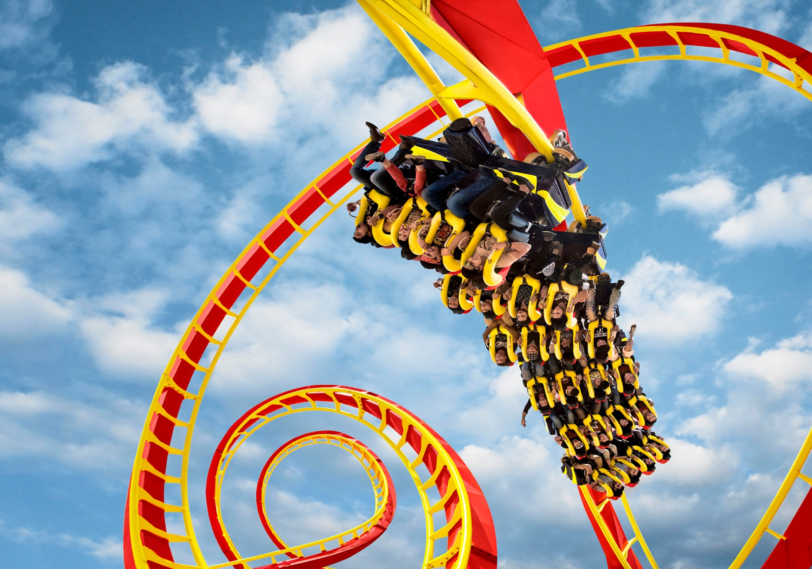
AMUSEMENT PARK MANAGEMENT
Submitted to-
Dr. Durga Toshniwal Associate Professor (CSE)
Submitted by-
Abhijeet Sharma (14535001)
Geeta (14535016)
Hariom Tiwari(14535017)
Monika (14535028)
Nikita Jain (14535031)
Nishtha Behal (14535032)
Priya Yadav (14535036)
Sonia Malik (14535046)
Yashika Jain (14535054)

Slide 2
Objective
AIM: To develop an effective management and business plan for an amusement park.
Techniques used: Association rule mining and Clustering.
Additionally, classification can be used.

Slide 3
Various Ideas which can be implemented
Find frequent rides and association rules between them using some association rule mining algorithm like Apriori.
Rides can be clustered based on complaints associated with the rides.
Cluster the rides to form zones like kids zone.
Find frequent patterns between different age groups.
Based on the load and the frequency of a particular age group we can increase or decrease the resources.
Use data mining techniques to better manage the food stalls.

Slide 4
Ideas we implemented
We have used apriori algorithm to find the frequent rides and association rules between them.
We have also used DBSCAN to cluster the rides based on the complaints.

Slide 5
Frequent patterns of rides
Technique used : Apriori algorithm
Apriori is an algorithm for frequent item set mining and association rule learning over transactional databases.
Apriori employs an iterative approach known as a level-wise search, where k-itemsets are used to explore (k+1)-itemsets.

Slide 6
Frequent patterns of rides
Data set :We were unable to find a real data set so we have generated data set with the following fields:
Ticket_ID: This indicates the ticket number of a particular customer.
Date: This indicates the date of the corresponding entry.
Rides_taken: This attribute will show the rides that the customer took.

Slide 7
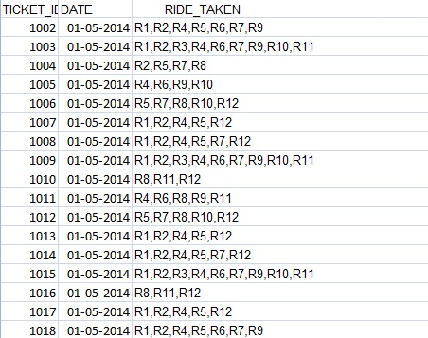
Frequent patterns of rides
Dataset

Slide 8
Frequent patterns of rides
Working of apriori:
Find all frequent item sets.
Generate strong association rules from frequent item sets
- Rules which satisfy the min. support and min. confidence threshold.
For finding the frequent item sets:
1. Frequent set Lk-1 is generated. In the beginning it is a set of singleton items sets which satisfy min. support.
2. Join step:
Candidate set Ck is generated by joining Lk-1 with itself.
3.Prune step :
Lk is generated by selecting only those sets in Ck which are subsets of more than threshold number of transactions. If the subset of any set in Ck is not there in Lk-1 then it is pruned.
After finding the frequent itemsets we can generate association rules.

Slide 9
Frequent patterns of rides
Results-
For a dataset with 600 entries we got the following results.
Support= 66 %, Confidence= 50% R9 --> R10, R11 R10 --> R9, R11 R11 --> R9, R11 R9, R10 --> R11 R9, R11 --> R10 R10, R11 --> R9
Support= 70%, Confidence=30% R9 --> R10 R9 --> R11 R10 --> R11

Slide 10
Applications: Frequent patterns of rides
Applications of result :
Set up food stalls near the frequently taken rides.
Put up help desks around frequent rides.
Introduce some infrequent rides between two frequent rides.
Introduce some coupons or offers to boost the infrequent rides.

Slide 11
Clustering of rides
We have clustered the rides based on the frequency of complaints.
Technique used- We have used DBSCAN (Density Based Spatial Clustering of Applications with Noise) for clustering the rides.
The algorithm is very suitable for finding clusters of arbitrary shapes.

Slide 12
Clustering the rides
Data set schema:
We have used a complaint table with the following attributes:
Complaint_no.: this attribute maintains the complaint number of a complaint uniquely.
Location_x: this attribute stores the x-coordinate of a ride or point in the area of amusement park relatively.
Location_y: this attribute stores the y-coordinate of a ride or point in the area of amusement park relatively.

Slide 13
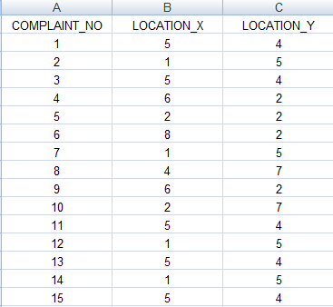
Clustering the rides
Complaint Dataset.

Slide 14
DBSCAN Algorithm
Create a graph whose nodes are the points to be clustered
For each core-point c create an edge from c to every point p in the ε-neighborhood of c
Set N to the nodes of the graph;
If N does not contain any core points terminate
Pick a core point c in N
Let X be the set of nodes that can be reached from c by going forward;
create a cluster containing X∪{c}
N=N/(X∪{c})
Continue with step 4

Slide 15
Complexity
Time Complexity: O(n²)—for each point it has to be determined if it is a core point, can be reduced to O(n*log(n)) in lower dimensional spaces by using efficient data structures (n is the number of objects to be clustered);
Space Complexity: O(n).

Slide 16
So why we used only DBSCAN?
Suitable because:
We can detect arbitrary shapes,
not very sensitive to noise,
supports outlier detection,
complexity is kind of okay,
beside K-means the second most used clustering algorithm.

Slide 17
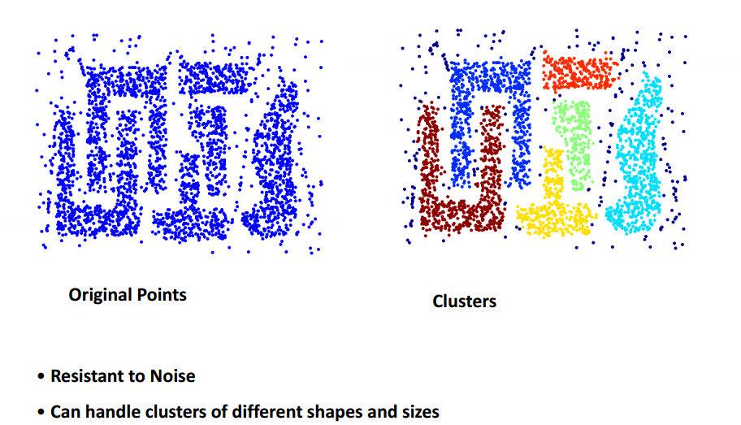
Clustered View

Slide 18
Clustered View (Using Rides)
Results:

Slide 19
Applications: Clustering the rides
Applications of the result :
Using the DBSCAN algorithm we can find the areas in the park that are more prone to accidents.
We can employ guards in that area.
We can put up first-aid services and/or ambulance within the approachable distance.
We may increase the frequency of maintenance of the rides.

Slide 20
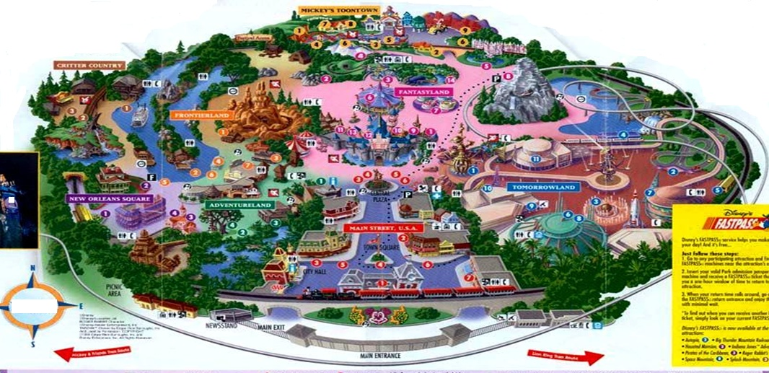
Demo

Slide 21
Cluster the rides to form zones
Rides can be clustered according to age group as well as the danger level in order to form various zones like kids zone.
Suitable algorithms- k-medoids.
Why k-medoids?
Its running time complexity is O(n).
It works well with numerical attributes.

Slide 22
Applications : Cluster the rides to form zones
Applications-
Place more caretakers around zones like kids zones.
Place washrooms close to the kid zone.
The food stalls can vary the kind of food they offer based on the zones they are in.

Slide 23
Frequent patterns on age groups
We can monitor the frequency of arrival of different age groups on special days/occasion for last few years.
Find frequent patterns on age and determine what could be the best times to offer various special schemes so as to increase profit.

Slide 24
Frequent patterns on age groups
Applications-
Introduce some discount coupons or catchy offers for frequent age groups to encourage them.
For infrequent age groups we may keep some special shows targeting that particular age group so as to step-up their frequency.

Slide 25
Analyze the load patterns
Based on the load and frequency of a particular age group we can determine the optimal amount of resources required.
We can use classification and prediction to predict the various load patterns based on the historic data.

Slide 26
Analyze the load patterns
Applications-
Various resources, particularly swimming costumes in case of water park can be increased depending on which costume size that is being used mostly.
We can also modify the food quantities on various days based on these results

Slide 27
Management of food court
Based on the eating patterns of the people visiting the food court we can improve its management.
The amount of resources required in future can be accurately predicted.
We can analyze what kind of food is preferred by most people i.e. frequent food items.

Slide 28
Management of food court
Suppose for example by analyzing last year’s data we find that during the month of May the frequent items are-
Pizza, Burger and Ice cream
We can be ready with increased supply of pizza bread, buns and ice creams the present year in the month of May.

Slide 29
Conclusion
So by embedding data mining techniques into the management of an amusement park we discover that we can increase the profit as well as security.
Data mining techniques allow more efficient use of resources.
We have primarily used association rule mining and clustering.

Slide 30
Thank You

